Slide 1
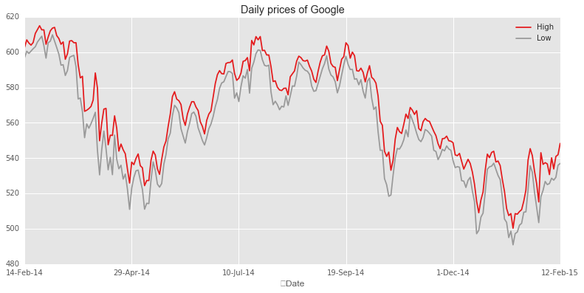
Analyzing “Hidden Patterns” in Stock Data Project Results Rutgers Data Science Bootcamp
Jan 12, 2018
Team 5
David Hui Timothy Yu Raj Ray

Slide 2
Project Scope and Goals
Objective and Scope
The goal of this project is to uncover patterns in the daily price action of a key stock traded in the US market.
Stock Selected – AAPL (Traded on the NASDAQ Exchange)
Time Interval - 3 year timeframe (2015-2017)
# of Datapoints – 252 trading days per year x 3 = 756
Factors to Consider – Examine relationships between
Daily closing price and the day of the month,
Daily stock price and its RSI indicator,
Daily stock price and volume
Data Source
Stock price data and technical indicators are pulled from the Alphavantage API
Tools Used
Python 3.0
Matplotlib

Slide 3
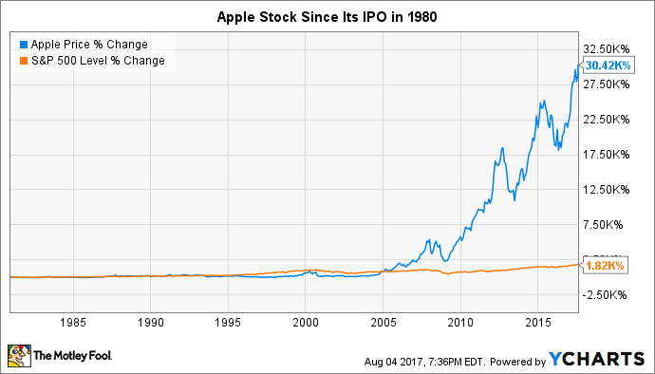
AAPL Stock Price Through the Years

Slide 4

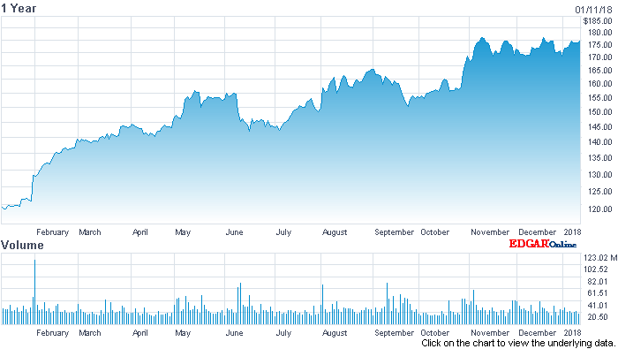
AAPL Stock Price (2017)
Apple Inc. Stock Chart

Slide 5

Key Questions
Questions to Address
Are there certain months that are better for buying or selling?
Does the RSI technical indicator (relative strength indicator) give more accurate signals on a larger timeframe than on a smaller timeframe? (i.e. 1 day vs 1 month)?
Price action and the RSI indicator -Test the assumption that the RSI is more accurate in larger timeframes in identifying overbought and oversold conditions.
Determine if our stock is currently overvalued or oversold based on historical data?
Is it possible to do any predictive analysis based on these patterns? (linear regression/ line fit)

Slide 6
Data Constraints and Analyses
Availability of APIs
Google and Yahoo APIs for stock market data have recently been shut down.
Other stock market APIs are not free.
Type of Data
Data on daily closing prices, volume and relative strengths are readily available from Alphavantage
Data Exploration
Additional data were also available on daily open, daily high, daily low, inter-day data etc. but those data were not considered or eliminated from input data streams to keep the data manageable for our analysis and to prevent scope creep.
Data Cleanup
The data obtained from Alphavantage were examined for errors, poor formatting or missing data. However, no such evidence was found.
Data Analysis
Time series analysis was performed by performing Y-O-Y comparisons.

Slide 7
Results (Plots)

Slide 8
Conclusions and Lessons Learned

